Slide 1
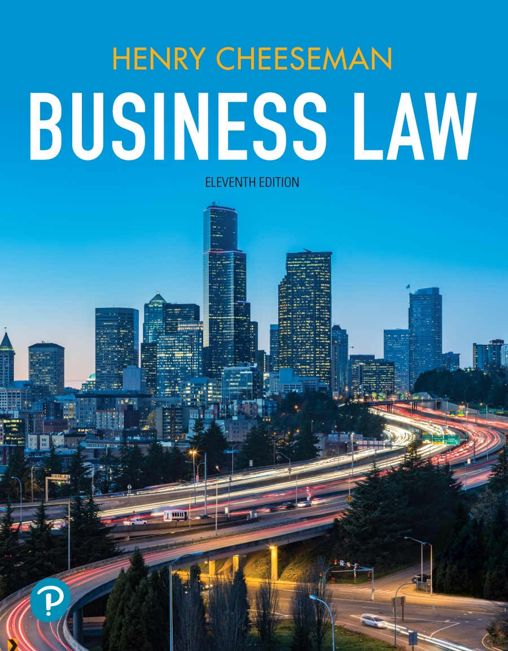
Business Law
Eleventh Edition
Chapter 42
Ethics and Social Responsibility of Business
Copyright © 2022, 2019, 2016 Pearson Education, Inc.

Slide 2
Learning Objectives
42.1 Describe how law and ethics intertwine.
42.2 Describe and apply the moral theories of business ethics.
42.3 Describe and apply the theories of the social responsibility of business.
42.4 Define public benefit corporation and describe the social purposes served by these corporations.

Slide 3
Law and Ethics
Ethics: A set of moral principles or values that governs the conduct of an individual or group
Rule of law and rule of ethics may demand the same response
Law may permit an act that is ethically wrong
Law may demand certain conduct, but a person’s ethical standards are contrary

Slide 4
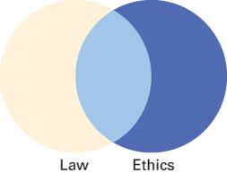
Exhibit 42.1: Law and Ethics

Slide 5
Case 42.1: Business Ethics
Case
Wal-Mart Stores, Inc. v. Samara Brothers, Inc.
Supreme Court of the U.S., 529 U.S. 205 (2000)
Facts
Wal-Mart copied plaintiff’s clothing line and sold the “knockoff” clothes at its stores. Wal-Mart was sued by plaintiff for violating the trade dress provision of Section 43(a) of the Lanham Act
Issue
Must a product’s design have acquired a secondary meaning before it is protected as trade dress?
Notes:
Holding for the case: Yes, if the trade dress is unregistered with the federal government.
For this case, focus less on the legal rule it creates and more on the ethicality of Wal-Mart’s actions.

Slide 6
Major Theories of Business Ethics
Ethical Fundamentalism
Utilitarianism
Rawls’s Social Justice Theory
Ethical Relativism
Kantian Ethics

Slide 7
Ethical Fundamentalism
A person looks to an outside source or a central figure for ethical rules or commands
This may be a book or a person
Ethical fundamentalism does not permit people to determine right and wrong for themselves

Slide 8
Case 42.2: Ethics
Case
Securities and Exchange Commission v. Zada
U.S. Ct. of Appeals for the 6th Cir., 787 F.3d 375 (2015)
Facts
Zada defrauded $56M from 60 people by claiming he was going to purchase oil on their behalf and provide a return of 40% in 2 months. The district court found that Zada violated antifraud provisions of securities law
Issue
Did Zada commit fraud?
Notes:
Holding for the case: Yes. If the notes are sold to a wide range of unsophisticated people, the notes are more likely to be securities.
For this case, focus less on the legal rule it creates and more on the ethical issues. Did Zada violate ethical principles? Was his promise to pay the investors a 40 percent return within two months “too good to be true?” Do the investors share responsibility for their plight?

Slide 9
Utilitarianism
People must choose the action or follow the rule that provides the greatest good to society
Origins in works of Bentham and Stuart
It has been criticized because:
It is difficult to estimate the “good” that will result from different actions
It is hard to apply
It treats morality as an impersonal calculation

Slide 10
Kantian Ethics
A person owes moral duties based on universal rules
The rules are based on two principles
Consistency – All cases are treated alike with no exceptions
Reversibility – Actor must abide by the rule he or she uses to judge the morality of someone else’s conduct
Critics argue that it is hard to reach a consensus as to what the universal rules should be

Slide 11
Case 42.3: Business Ethics
Case
Wysong Corp. v. APN, Inc.
U.S. Ct. of Appeals for the 6th Cir., 889 F.3d 267 (2018)
Facts
Defendant’s dog food packaging showed photographs of delectable lamb chops, T-bone steaks, and chicken on its packaging but it was trimmings from those meats
Issue
Have the defendant pet food manufacturers engaged in false advertising and misleading labeling?
Notes:
Holding for the case: No. Reasonable consumers know that marketing involves some level of exaggeration—what the law calls “puffery.” Mere puffery is not actionable under the Lanham Act.
For this case, focus less on the legal rule it creates and more on the ethical issues. What is an outrageous example of puffery that you know of? Is it ethical for businesses to engage in puffery? Should producers and sellers be more honest in advertising and labeling their products?

Slide 12
Rawls’s Social Justice Theory (1 of 2)
A person has a social contract with all others in society to obey moral rules that are necessary for people to live in peace and harmony
Origins in work of Locke and Rousseau
The principles of justice should be chosen by persons who do not yet know their station in society
This veil of ignorance would permit the fairest possible principles to be selected

Slide 13
Rawls’s Social Justice Theory (2 of 2)
Major criticisms of this theory
Establishing the blind “original position” for choosing moral principles is impossible in the real world
Many persons in society would choose not to maximize the benefit to the least advantaged persons in society

Slide 14
Ethical Relativism
A person must decide what is ethical based on his or her own feelings as to what is right or wrong
No universal ethical rules to guide a person’s conduct
Critics argue that actions widely regarded as unethical, would be seen as ethical, depending on perpetrator’s viewpoint

Slide 15
Case 42.4: Nondisclosure of Evidence
Case
Goodyear Tire & Rubber Company v. Haeger
S.C. of the U.S., 137 S.Ct. 1178 (2017)
Facts
Goodyear withheld evidence from plaintiffs who were badly injured by problems with Goodyear’s tires
Issue
Should the plaintiffs recover their entire attorneys’ fees of $2.7 million?
Notes:
Holding for the case: Yes. The U.S. district court found that Goodyear had engaged in a years-long course of bad-faith behavior. Here, the conduct arose to a truly egregious level. Federal courts possess the ability to fashion an appropriate sanction for conduct which abuses the judicial process. A sanctioning court must determine which fees were incurred because of, and solely because of, the misconduct at issue.
For this case, focus less on the legal rule it creates and more on the ethical issues. Did Goodyear act ethically in this case? Should the plaintiffs be awarded the entire amount they spent on attorneys’ fees? Do you think the amount of damages that will be awarded will prevent similar conduct in the future?

Slide 16
Social Responsibility of Business (1 of 2)
Corporations and businesses should act with awareness of the consequences and impact that their decisions will have on others
Corporations and businesses are considered to owe some degree of responsibility for their actions

Slide 17
Social Responsibility of Business (2 of 2)
Maximizing Profits
Moral Minimum
Corporate Citizenship
Stakeholder Interest

Slide 18
Maximizing Profits
Corporation owes a duty to take actions that maximize profits for shareholders
Interests of other constituencies are not important in and of them

Slide 19
Moral Minimum
Corporation’s duty is to make a profit while avoiding harm to others
As long as business avoids or corrects the social injury it causes, it has met its duty of social responsibility
Legislative and judicial branches of government have established laws to enforce moral minimum

Slide 20
Sarbanes-Oxley Act
Companies must disclose whether they have a code of ethics for senior financial officers
Compelling public companies to act ethically in dealings with shareholders, employees, and other constituents
Makes certain conducts illegal and establishes criminal penalties for violations

Slide 21
Stakeholder Interest
Corporation must consider the effects its actions have on persons other than its shareholders
Critics argue that it is difficult to harmonize the conflicting interests of stakeholders

Slide 22
Corporate Citizenship
Business has a responsibility to do good
Corporations owe a duty to promote the same social goals as individual members of society
Major criticism of this theory is that the duty of a corporation to “do good” cannot be expanded beyond certain limits

Slide 23
Public Benefit Corporations
A corporation that requires directors and officers to make decisions to accomplish general-public benefits and stipulated specific public benefit purposes stated in the articles of incorporation
Must consider stakeholders other than shareholders, such as employees, customers, suppliers, and the community, when making corporate decisions

